Slide 1
Transformers

Slide 2
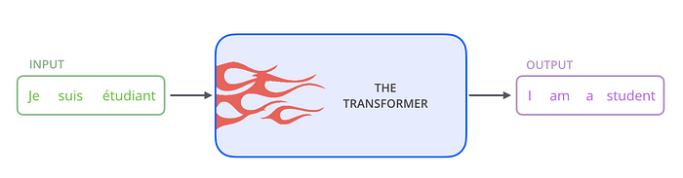

Slide 3
To solve the problem of parallelization, Transformers try to solve the problem by using encoders and decoders together with attention models. Attention boosts the speed of how fast the model can translate from one sequence to another.
How Transformer works. Transformer is a model that uses attention to boost the speed. More specifically, it uses self-attention.
The Transformer consists of six encoders and six decoders.
Each encoder is very similar to each other. All encoders have the same architecture. Decoders share the same property, i.e. they are also very similar to each other. Each encoder consists of two layers: Self-attention and a feed Forward Neural Network.

Slide 4
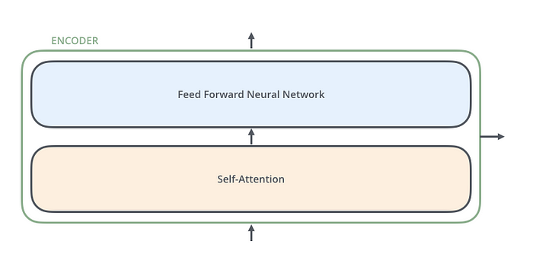

Slide 5
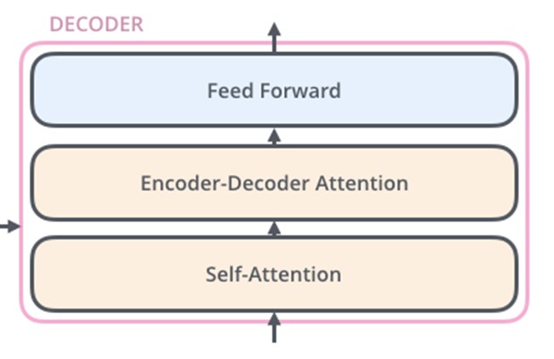
The encoder’s inputs first flow through a self-attention layer. It helps the encoder look at other words in the input sentence as it encodes a specific word. The decoder has both those layers, but between them is an attention layer that helps the decoder focus on relevant parts of the input sentence.

Slide 6

Self-Attention Example
To turn the input of a trained model into an output.
NLP application
Turn each input word into a vector using an embedding algorithm.
Each word is embedded into a vector of size 512.
The embedding only happens in the bottom-most encoder.
The abstraction that is common to all the encoders is that they receive a list of vectors each of the size 512.
2. After embedding the words in the input sequence, each of them flows through each of the two layers of the encoder.

Slide 7
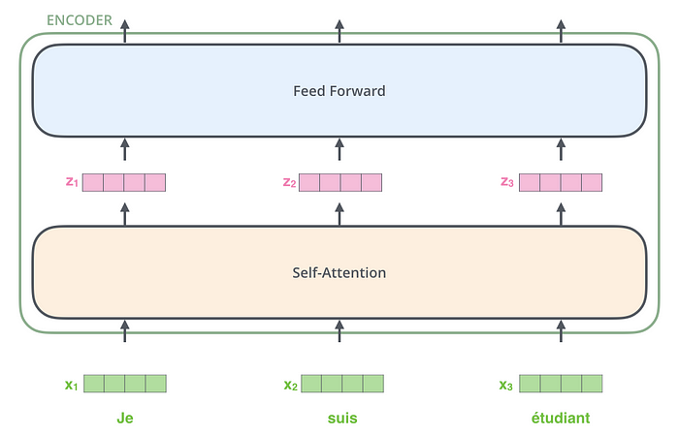

Slide 8
In Transformer,
The word in each position flows through its own path in the encoder. There are dependencies between these paths in the self-attention layer. The feed-forward layer does not have those dependencies, however, and thus the various paths can be executed in parallel while flowing through the feed-forward layer.

Slide 9
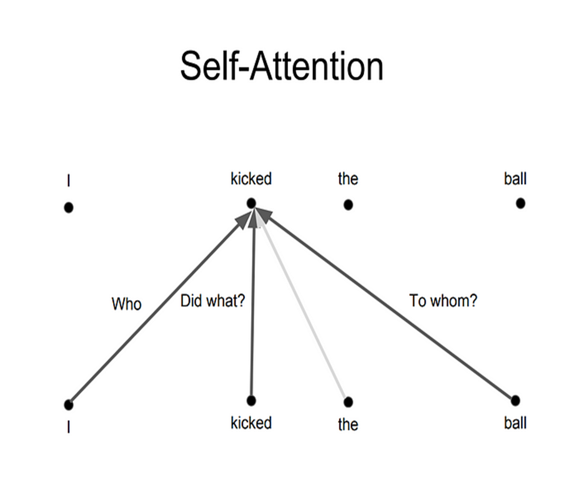
Self Attention Layer

Slide 10
The first step in calculating self-attention is to create three vectors from each of the encoder’s input vectors (in this case, the embedding of each word).
So for each word, we create a Query vector, a Key vector, and a Value vector.
These vectors are created by multiplying the embedding by three matrices that we trained during the training process.
Their dimensionality is 64, while the embedding and encoder input/output vectors have dimensionality of 512.

Slide 11
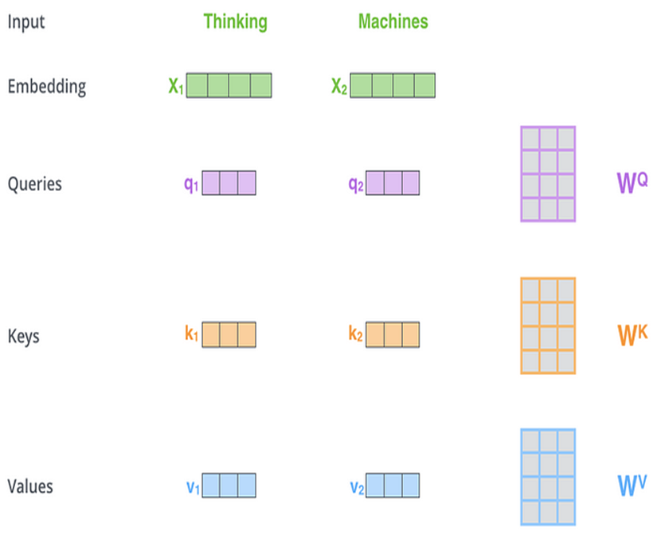

Slide 12
Multiplying x1 by the WQ weight matrix produces q1, the “query” vector associated with that word. We end up creating a “query”, a “key”, and a “value” projection of each word in the input sentence.
What are the “query”, “key”, and “value” vectors?
They’re abstractions that are useful for calculating and thinking about attention. Once you proceed with reading how attention is calculated below, you’ll know pretty much all you need to know about the role each of these vectors plays.

Slide 13
The second step in calculating self-attention is to calculate a score. Say we’re calculating the self-attention for the first word in this example, “Thinking”. We need to score each word of the input sentence against this word. The score determines how much focus to place on other parts of the input sentence as we encode a word at a certain position.
The score is calculated by taking the dot product of the query vector with the key vector of the respective word we’re scoring. So if we’re processing the self-attention for the word in position #1, the first score would be the dot product of q1 and k1. The second score would be the dot product of q1 and k2.

Slide 14
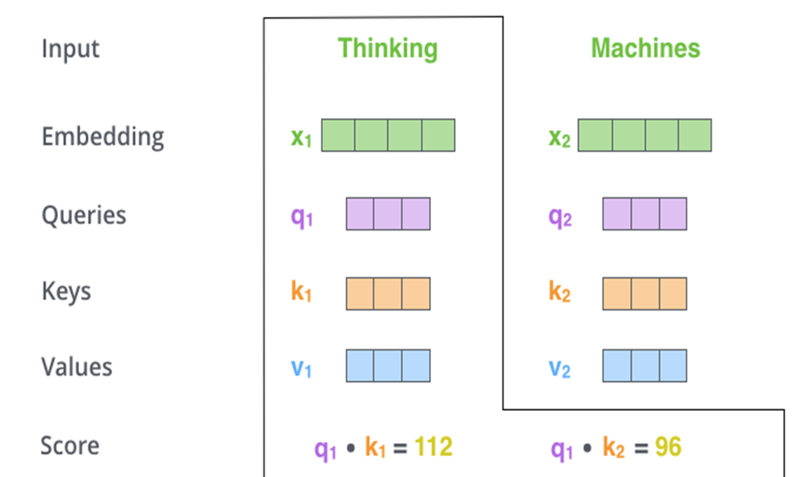

Slide 15
The third and fourth steps are to divide the scores by 8 (the square root of the dimension of the key vectors used in the paper — 64. This leads to having more stable gradients. There could be other possible values here, but this is the default), then pass the result through a softmax operation. Softmax normalizes the scores so they’re all positive and add up to 1.

Slide 16
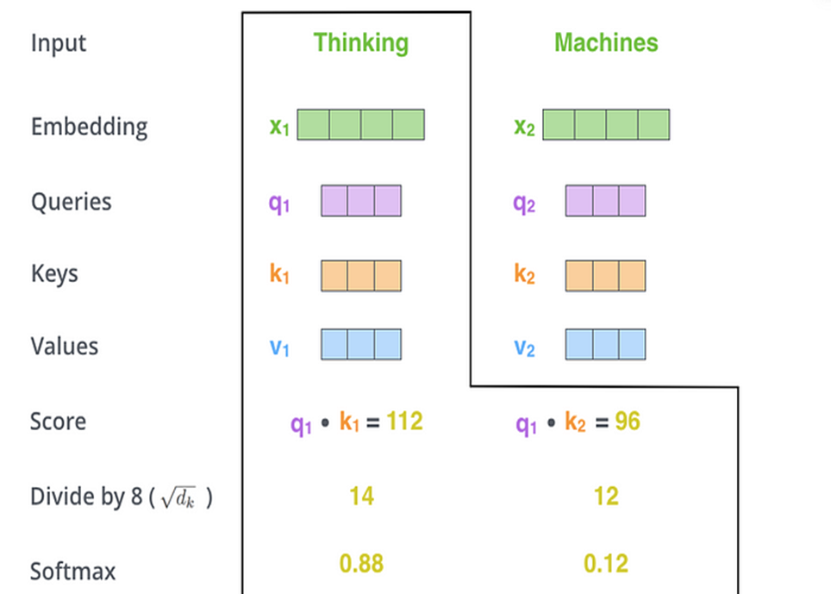

Slide 17
This softmax score determines how much how much each word will be expressed at this position. Clearly the word at this position will have the highest softmax score, but sometimes it’s useful to attend to another word that is relevant to the current word.
The fifth step is to multiply each value vector by the softmax score (in preparation to sum them up). The intuition here is to keep intact the values of the word(s) we want to focus on, and drown-out irrelevant words (by multiplying them by tiny numbers like 0.001, for example).
The sixth step is to sum up the weighted value vectors. This produces the output of the self-attention layer at this position (for the first word).

Slide 18
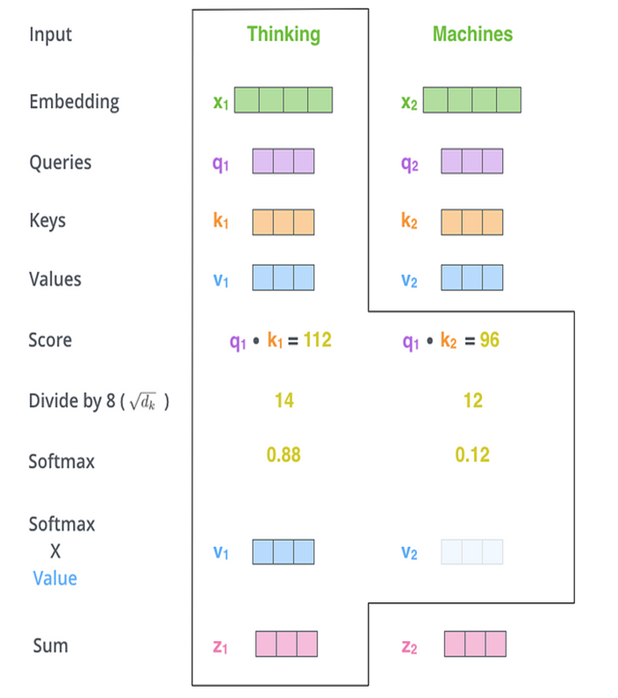

Slide 19
From the Self Attention to FF network:
The resulting vector is one we can send along to the feed-forward neural network. In the actual implementation, however, this calculation is done in matrix form for faster processing.

Slide 20
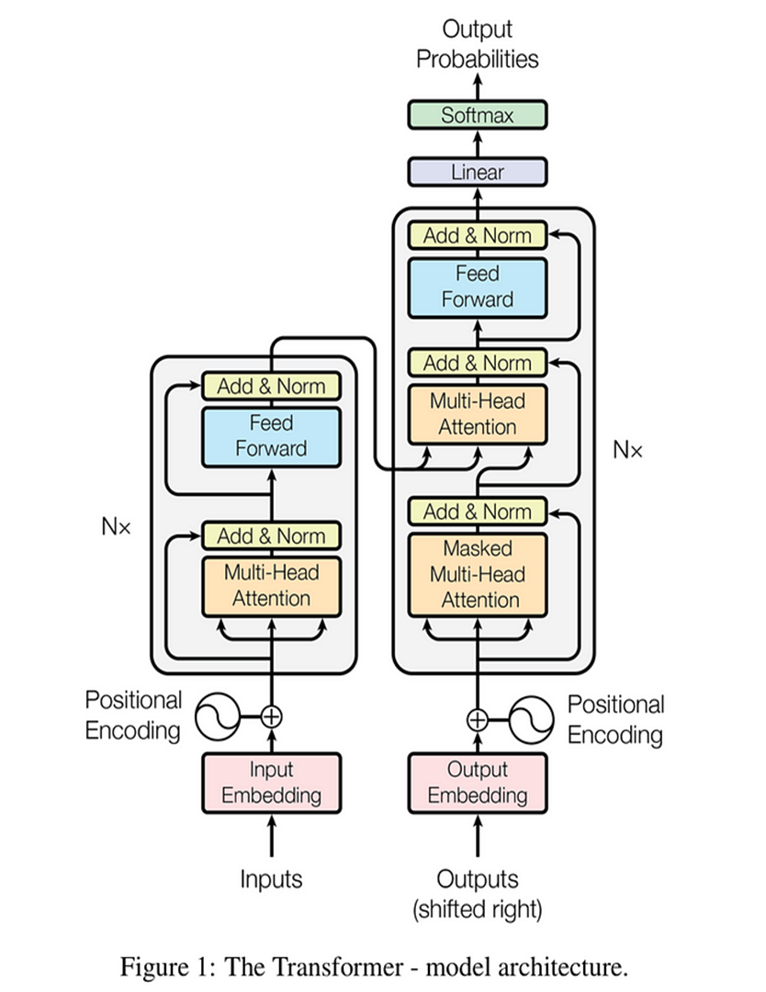

Slide 21
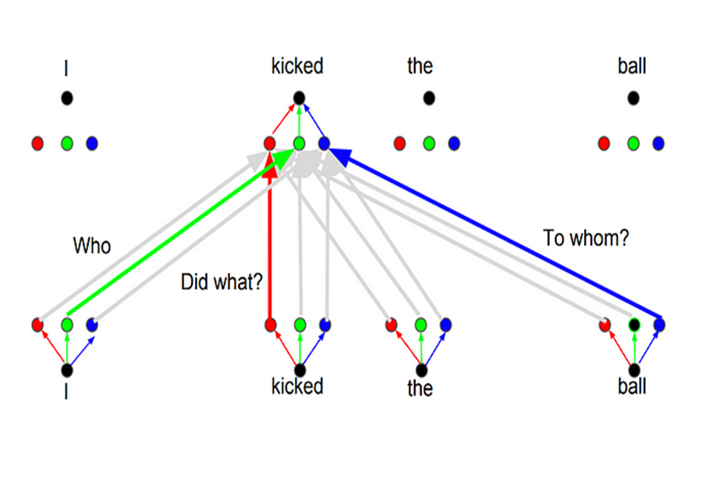
Multihead attention
The idea behind it is that whenever you are translating a word, you may pay different attention to each word based on the type of question that you are asking.
Whenever you are translating “kicked” in the sentence “I kicked the ball”, you may ask “Who kicked”. Depending on the answer, the translation of the word to another language can change.

Slide 22
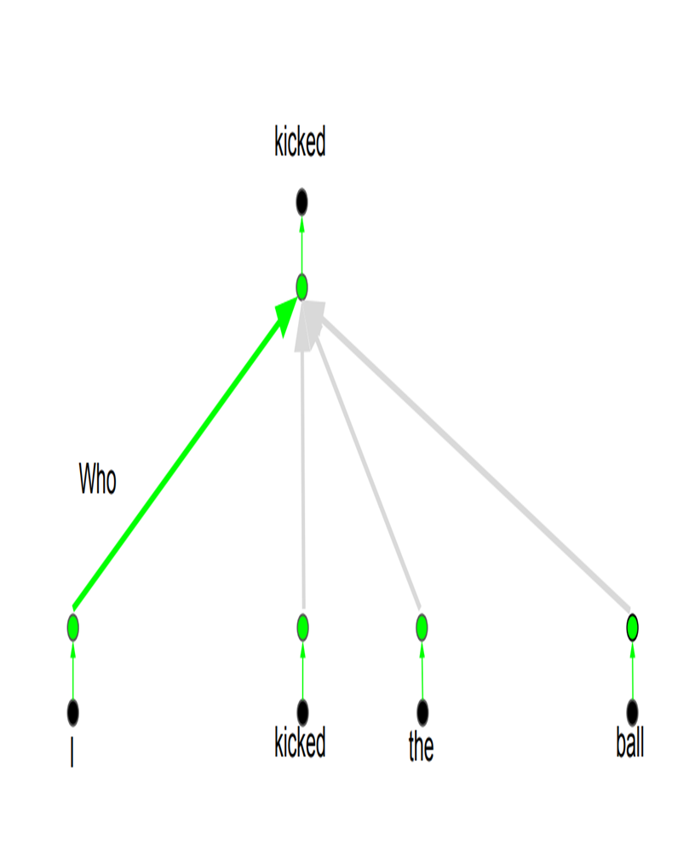

Slide 23
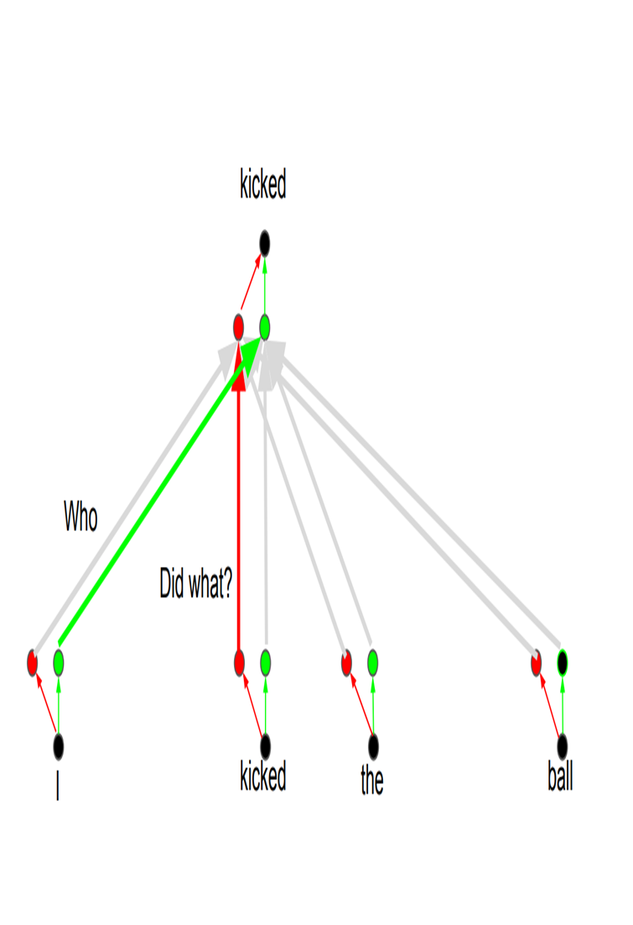

Slide 24
Positional Encoding
Another important step on the Transformer is to add positional encoding when encoding each word. Encoding the position of each word is relevant, since the position of each word is relevant to the translation.

